Slide 1
Trade Management System

Slide 2
Introduction
Trade management System is focused on the billing system of a hardware store
Modernizing Billing and Invoicing for Bhageswor Hardware and Suppliers
Its main job is to make the billing process at the hardware store much easier and faster.

Slide 3
Objectives
Replace manual paper-based systems with digital solutions to eliminate the use of handwritten records and enhance accuracy.
Optimize time, resource, and financial expenditure for the organization and promoting efficiency and cost-effectiveness.
Enhance customer satisfaction by ensuring accurate and prompt billing processes.

Slide 4
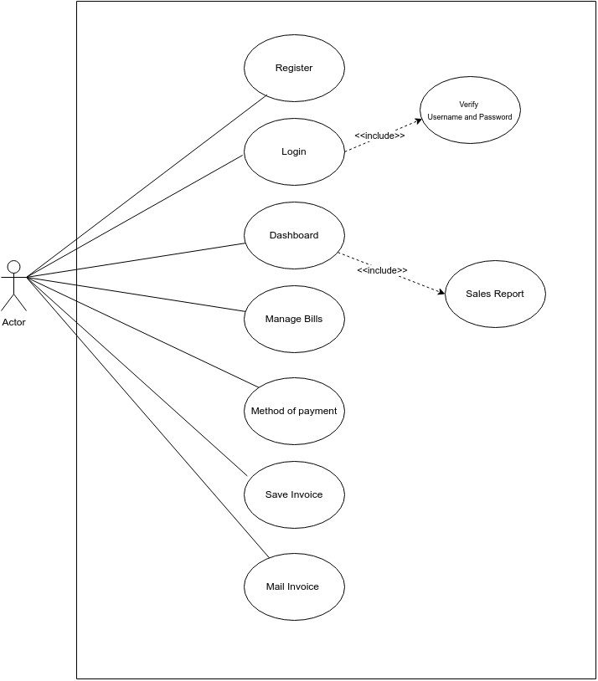
Proposed System

Slide 5
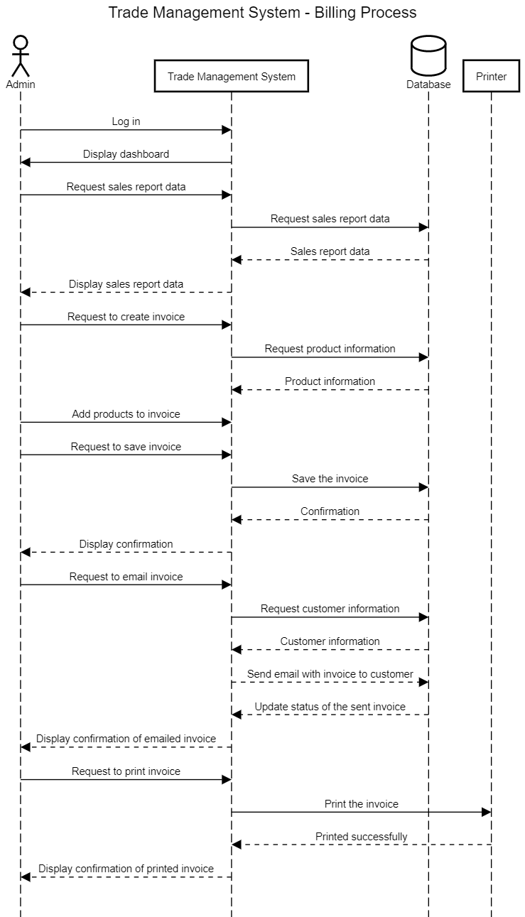

Slide 6
Conclusion
Hardware stores in Nepal are witnessing substantial growth, attracting customers for construction and home repair needs.
Ensuring fast, efficient, and accurate billing creates a positive impression, leading to customer satisfaction.
Embracing technology can further elevate hardware stores, meeting evolving customer expectations and enhancing community reputation.

